Slide 1
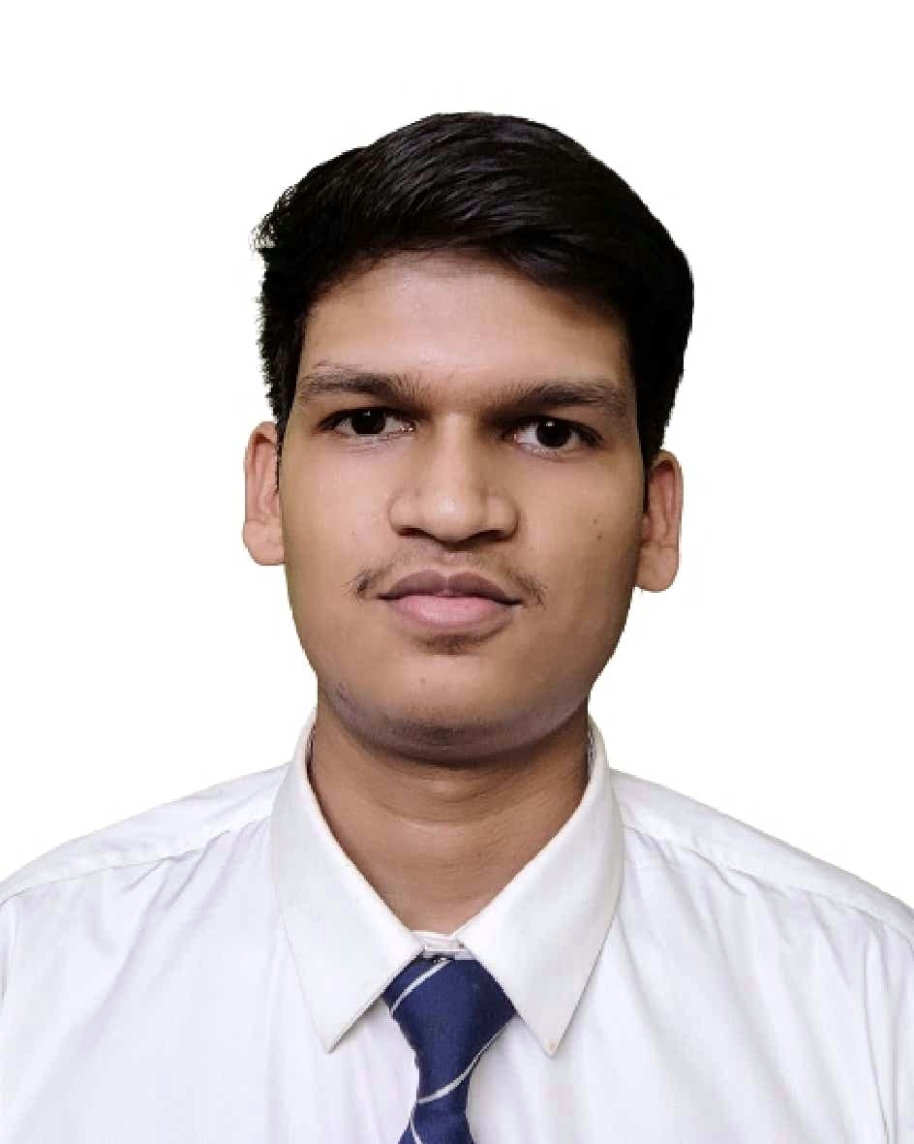



Devanshu Kushwah
Analyst/Software Engineer
Bachelor of Engineering
Electrical Engineering: 2017- 2021
Java 8
Spring Boot
Spring MVC
JPA CRUD
MEAN Stack
Angular
NodeJS
MongoDB
Database
SQL database – DB2
No SQL database – MongoDB
Web Technologies
HTML5
CSS3
Java Script
Add Ons
GitHub
Maven
Postman
Bitbucket
Additional Details
Good Communication Skills
Team Player
Gurgaon
Skills
devanshu.kushwah@capgemini.com
+91 8839119708
A4
Full Stack Developer
Hands on experience in creating microservices with Spring boot, Spring Security, Spring Cloud API Gateway, Eureka server.
Java Microservice Development knowledge using Spring boot and spring cloud framework on an intermediate level.
Hands on experience in implementing Angular & spring boot.
Experience in creating documentation with swagger.
In-depth understanding of deploying spring boot applications
On Muzix App
Completed end to end case study of Muzix Application along with JWT authentication, Swagger responsive UI with CSS and Angular used for user interface.
Check out my work on GitHub & Video Profile

